Slide 1
PMTCT WESTERN CAPE POLICY
ESMOE 2020
GS GEBHARDT
HA Swart

Slide 2
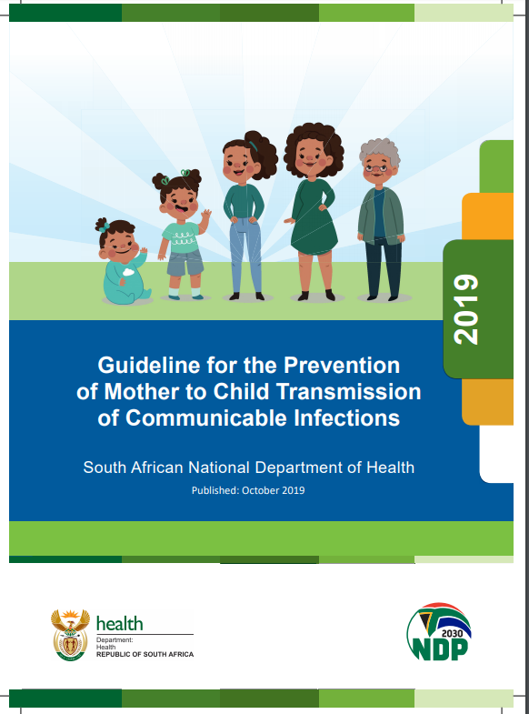

Slide 3
PMTCT program: four pillars to achieve the targets of HIV-free generation.

Slide 4
When to test
All pregnant, BF or up to one year post partum clients with ?/prev negative HIV status
HIV Counselling and Testing (HCT) on the same day that they present.
HCT as individuals or couples.

Slide 5
When to test
Repeat HIV testing at the following intervals:
• Around 20 weeks gestation (second trimester)
• Around 32 weeks gestation (third trimester)
• In labour/immediately after delivery
• At 6 weeks after delivery
• Every 3 months while breastfeeding

Slide 6
Who gets treatment?
All HIV-infected women (any CD4 count) are eligible for lifelong antiretroviral therapy (ART).

Slide 7
Fixed dose combination (FDC)
Current first line: TLD: combination of
Tenofovir 300mg (TDF)
Lamivudine 300mg (3TC)
Dolutegravir 50mg (DTG)
Previous first line
Tenofovir 300mg (TDF)
Emtricitabine 200mg (FTC)
Efavirenz 600mg (EFV)

Slide 8
Dolutegravir
Preferred first-line ART regimen in SA
Advantages
Superior Efficacy
side-effects mild and uncommon
high genetic barrier to resistance
cost effective
no interaction with hormonal contraceptives
can be used with TB treatment if boosted

Slide 9
Risk of NTD with DTG
DTG may increase risk of neural tube defects (NTDs).
The absolute risk is very low and translates into a risk difference of 2 additional NTDs per 1000 periconception exposures to DTG (0.3% risk), compared to EFV ART at conception (0.1% risk).
Periconception and in the first 6 weeks of pregnancy: pts must be informed of this increased risk
DTG appears to be safe if started after the neural tube has closed (>6w, no risk of NTDs)

Slide 10
Risk of NTD with DTG cont...
Any non-pregnant woman taking or starting DTG should be advised to use contraception and folic acid supplements.
Non-pregnant woman using DTG
discuss fertility intentions at every visit.
Planning to fall pregnant plus concerned of NTDs risk
Offer to switch from TLD to TEE (if supressed VL past 6 months)
Pregnant women already on an EFV containing ART regimen may switch to DTG containing regimen.

Slide 11
3 important screenings
TB: may delay start of ART and affect Isoniazid Prophylactic Therapy (IPT)
Neuropsychiatric (EFV contra-indicated)
Renal (TDF contra-indicated)

Slide 12
Screen for TB
HIV+ women: active TB disease common
All pregnant women: actively screen for TB symptoms at every visit
ALL HIV+ women (new or known) or HIV- with symptoms
sputum specimen (x2) must be collected for GeneXpert testing

Slide 13
TB Screen: send 2x sputum if any of the following
1. Current cough
2. Sputum production
3. Fever
4. Drenching night sweats
5. Unexplained weight loss
6. Loss of appetite, malaise, tiredness
7. Shortness of breath, chest pains
8. New palpable lymphadenopathy

Slide 14
TB preventative therapy (TPT)
TPT dosage
Isoniazid (INH) 300 mg daily PO, and Pyridoxine 25 mg OD PO x 12 months
If CD4>100: start 6w post partum
If CD4<100: if GXP negative, initiate TPT
Contra-indications to TPT
Positive TB symptom screen
Alcohol abuse
Liver disease
Known hypersensitivity to INH

Slide 15
Any contraindication to FDC
Start AZT provided haemoglobin is acceptable
Refer for expert within 7 days

Slide 16
Do the following at the first visit (in addition to standard package of care):
Baseline bloods: HIV Elisa, VL, CD_{4,} FBC, Creat, ALT, RPR (if not known), HBsAg, serum Cryptococcal Antigen (CLAT) test if CD₄ < 100
Repeat Viral Load if result > 3 months old
PAP smear (if none done in the past year)
STI screening
TB PCR – GeneXpert x 2

Slide 17
VL monitoring during pregnancy
Detailed flow chart (see next slide)
Ensure you have access to it
Important to note
VL are used to monitor patient during pregnancy/BF
VLs are done more regularly and reacted to more aggressively compared to non-pregnant/BF pts due to transmission risk to babies
If VL suppressed on ART, only repeat again during labour (previously every 3 months)

Slide 19
VL monitoring during BF
Aim for VL , 50 c/mL: then repeat every 6 months while BF
Refer to flow chart (next slide) if VL unsuppressed
Align tests and visits with EPI visits

Slide 21
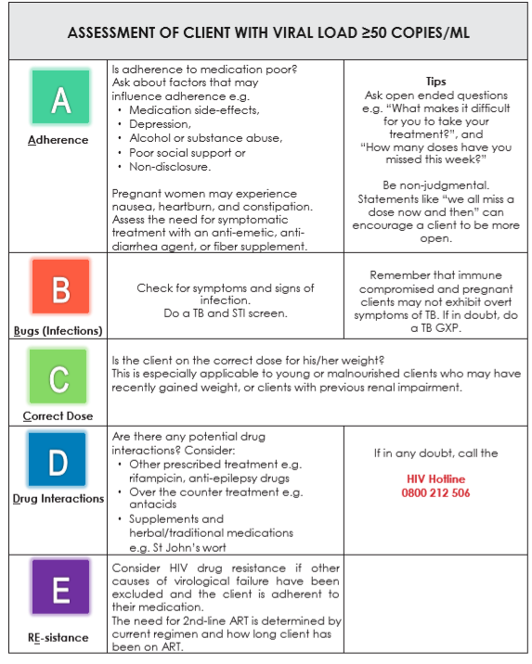

Slide 22
Indications to discuss with ID
Baseline serum creatinine > 85 umol/l or creatinine clearance less than 50 ml/min*
Increase in serum creatinine after initiation of Tenofovir
Psychiatric illness
Decrease in Hb after initiation of Zidovudine
Poor response to TB treatment or suspicion of IRIS
Change in clinical stage of disease while on ART (especially weight loss during pregnancy)
Clinical signs of possible meningitis: e.g. confusion; headaches
Any doubts or questions regarding current ARV regimen or lab results

Slide 23
ART during labour if HIV status unknown/not on Rx
NVP 200mg stat, Truvada® (Tenofovir/Emtricitabine) stat, AZT 300mg 3hly
OR
TLD :stat single fixed-dose combination tablet and a stat NVP 200mg

Slide 24
COTRIMOXAZOLE PREVENTIVE THERAPY (CPT
Indications
CD4 <200 cells/uL
Co-infection with TB
Any WHO stage 2,3 or 4 condition
CPT is safe to use in pregnancy and breastfeeding.
Recommended dose of CPT: Cotrimoxazole 160/800mg daily

Slide 25
Infant feeding
Counsel at multiple antenatal visits
BF 24 months encouraged
Introduce solids at 6 months
MIXED FEEDING IS ALLOWED if on ARVs
Formula IF
Mom failing regiment 3
Mom too sick to breastfeed

Slide 27
End

